Slide 1

The Entrepreneurship Network, Internship
MACHINE LEARNING
Core task –1
Employee ID – TEN/ML/371
Presented by,
Ashlesha Datir.

Slide 2
CORE TASK 1
This task will help you in boosting your knowledge in core domain, n help you in completion of upcoming tasks.
📌Here's a playlist consisting of videos to boost your Domain
knowledge:https://youtube.com/playlist?list=PLEiEAq2VkUULYYgj13YHUWmRePqiu8Ddy
Go through them n study these videos thoroughly, after that prepare a report based on your understanding.
🗒️Submission:●You may prepare the report in any of the formats, in which you are comfortable with.
●But before submitting makesure to convert it into PDF file n submit.

Slide 3
Machine Learning :
Machine learning is a system learns form historical data, builds the prediction model and whenever it receive new data, predicts the output for it.
Three Types of Machine Learning :
1.Supervised Machine Learning.
Supervised Learning algorithm are trained using labeled data.
2. Unsupervised Machine Learning.
Unsupervised Learning algorithm are trained using unlabeled data.
3. Reinforcement Machine Learning.
Reinforcement Machine Learning is a feedback-based learning method.
In which a Learning agents gets a reward for each right action and get penalty for each wrong action .
The agent learns automatically with these feedbacks and improves its performance.
In reinforcement learning, the agent interacts with the enironment and explores it
The goal of an agent is to get the most reward points, and hence , it improves its performances
Example :The robotic dog, which automatically learns the movement of his arms.

Slide 4
Supervised and Unsupervised:
Supervised
Supervised Learning algorithm are trained using labeled data.
Model takes direct feedback to check whether it is predicting correct output or not.
Model predict the output.
Goal : To train model so that it can predict the output when it give new output.
Need Supervision to train the model.
Used for those cases where we know the input as well as corresponding output data.
Categorized in Regression and Classification.
SL is not close to AI as in this case, we first train the model for each data & then only it can predict the correct output
Include algorithm : Regression, Decision Tree , SVM, Multi-class Classification , K-Neighbour , Logistic Regression.,etc
Unsupervised
1. Unsupervised Learning algorithm are trained using unlabeled data.
2.Model does not take any feedback.
3. Model finds the hidden pattern.
4.Goal : To find the hidden pattern & useful insights from the unknown dataset.
5.Do not need supervision to train the model.
6.Used for only those cases where we know only input data and no corresponding output data.
7.Classified in clustering and Association.
8.More close to true AI as it learn similarity as a child learns daily routine things by his experiences.
9.Include algorithum : Clustering, KNN, Apriori Algorithum.,etc

Slide 5
Applications Of Machine Learning:
Virtual Personal Assistants i.e., Google assistant Cortana Siri Alexa.
Traffic prediction.
Social media personalization.
Email spam filtering
Online fraud detection.
stock Market training.
Assistive medical technology.
Transaction translation.

Slide 6
Linear Regression : Linear regression is a statistical model used to predict the relationship between independent and dependent variable. Independent variable : A variable whose values does not change by the effect of other variables and is used to manipulate the dependent variable. It is often denoted as X. Dependent Variable : A variable whose value change when there is any manipulation in the values of independent variable. It is denoted as Y.
Application of Linear Regression :
1 . Used to determine economic Growth of a country or a state in the coming quarter, can also be used to predict the GDP of a country.
2.Product price can be used to predict what would be the price of product in the future.
3.Housing sales to estimate the number of houses a builder would sale and at what price in the coming months.
4.Score prediction to predict the number of runs a player score in the coming matches based on the previous performance.

Slide 7
Multiple Linear Regression: Multiple Linear regression is a statistical model used to predict the relationship between more than one independent and single dependent variable.
Application of Multiple Linear Regression :
1. Linearity :Linearity the relationship between dependent and independent variable should be the linear.
2.Homoscedasticity (Constant variance) Of the error should be maintained.
3.Multivariate normality : multiple regression assumes that the residuals are normally distributed.
4.Lack of multicollinearity it is assumed that there is a little or no multicollinearity in the data. multicollinearity occurs when the features(independent variables) are not independent of the other.

Slide 8
Logistic Regression : Logistic regression is used for a different class of problem known as a classification problem predict the group to which the current object under observation belongs to it is key it gives you a discrete binary outcomes between 0 and 1 a simple example would whether a person will vote or not in upcoming elections.
How Does It Work ?
Logistic Regression measures the relationship between the dependent variable (our label , what we want to predict ) and the one or more independent variables ( our features), by estimating probabilities using it’s underlying logistic function.

Slide 9
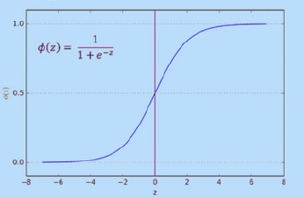
Sigmoid Function : The Sigmoid-Function is an S-shaped curve that can take any real-valued number and map it into a value between the range of 0 to 1 , but never exactly at those limits.
Making Predictions :
These probabilities must then be transformed into binary values in order to actually make a predication . This is the task of the logistic function, also called the sigmoid function. This values between 0 and 1 will then be transformed into either 0 or 1 using a threshold classifier.
Logistic Vs Linear : Logistic regression gives you a discrete outcome but linear regression gives a continuous outcome.

Slide 10
Making predictions: To classify unlabeled object ,The distance of the object to the labeled object is computed, it’s k nearest neighbor identified, and the class label of the majority of nearest neighbors is then used to determine the class label of the object. for real value input variables, the most popular distance measure is Euclidean distance.
K-NN Classification Algorithm( Lazy Learner):
K-Nearest Neighbor algorithm is a simple yet most used classification algorithm .It can also be used for a regression .KNN is non parametric (means that it does not make any assumptions on the underlying data distribution) ,instance-based (means that our algorithm doesn't explicitly learn a model. Instead, it chooses to memorize the training instances) and used in a supervised learning setting.
The Distance Euclidean Distance is calculated as the square root of the sum of the square difference between a new points and the existing point across all input attributes . other popular distance measure include
hamming distance .
Manhattan distance
Minkowski distance
Value of K Finding the k value is not easy a small value of ‘k’ that noise will have the higher influence on the result and a large value makes its computationally expensive. It depends a lot on your individual case sometimes it is the best way to run through each possible value for k and decide for yourself .

Slide 11
How Does K-Mean Clustering works :
Elbow Point :
The Idea of the elbow method is to run K-Mean clustering on the dataset where ‘k’ is referred as number of cluster.
Each value of k within sum of square measured and the value of WSS is least that taken as a optimum value of k.
Measure of distance:
Euclidean Distance is a distance measure used to find out which data point is closest to our centroids.
Grouping:
Based upon the distance from C1 and C2 centroids , the data points will group itself into clusters
Reposition the centroids:
Reposition the centroid of the clusters to the new centroid
Convergence :
Once the clusters become static k-means clustering algorithm is said to be converged

Slide 12
CLUSTERING :
Clustering
Hierarchical
Clustering
Partitional
Clustering
Agglomerative
Divisive
K-Means
Fuzzy C-means
“Bottom up” approach : Begin with each element as a separate cluster and merge them into successively large cluster
“Top Down” approach : Begin with the whole set and procced to divide it into successively smaller cluster.
Division of object into clusters such that each object is in exactly one cluster, not several
Division of object into clusters such that each object can belong to multiple clusters.

Slide 13
Decision Tree Algorithm:
It is a type of supervised learning algorithm that is mostly used in classification problem and works for both categorical and continuous inputs and output variables.
A decision tree is a tree in which each branch node represents a choice between a number of alternatives and each leaf node represents a decision.
Advantages of Decision Tree :
Simple to understand, interpret and visualize.
Little efforts required for data preparation.
Handel both numerical and categorical data.
Non- Linear parameter don’t affect its performance.
Dis-Advantages of Decision Tree:
Overfitting Occurs when the algorithm captures noise in the data.
High Variance The model can get unstable due to small variation in data.
Low biased A highly complicated Decision tree tends to have a low bias which makes it difficult for the model to work with new data.

Slide 14

Decision Tree Algorithm :ID3
ID3 stands for Iterative Dichotomizer 3.The basic idea is to construct the decision tree by employing a top-down, greedy search through the given sets to test each attribute at every tree node.
Sounds simple-but which node should we select to build the correct and most precise decision tree ?How would we decide that ? Well, we have some measure that can help us in selecting best choice
ENTROPY is the measure oof randomness or unpredictability in the dataset (More Randomness i.e more entropy, Less Randomness i.e. low entropy)
INFORMATION GAIN is the measure of decrease in entropy after the dataset is split (Gain is the measure of decrease in entropy after splitting)
Gain =High Entropy (s1) - Low Entropy(s2)
ROOT NODE the top most decision node is known as the root node.
LEAF NODE carries the classification or the decision.

Slide 15
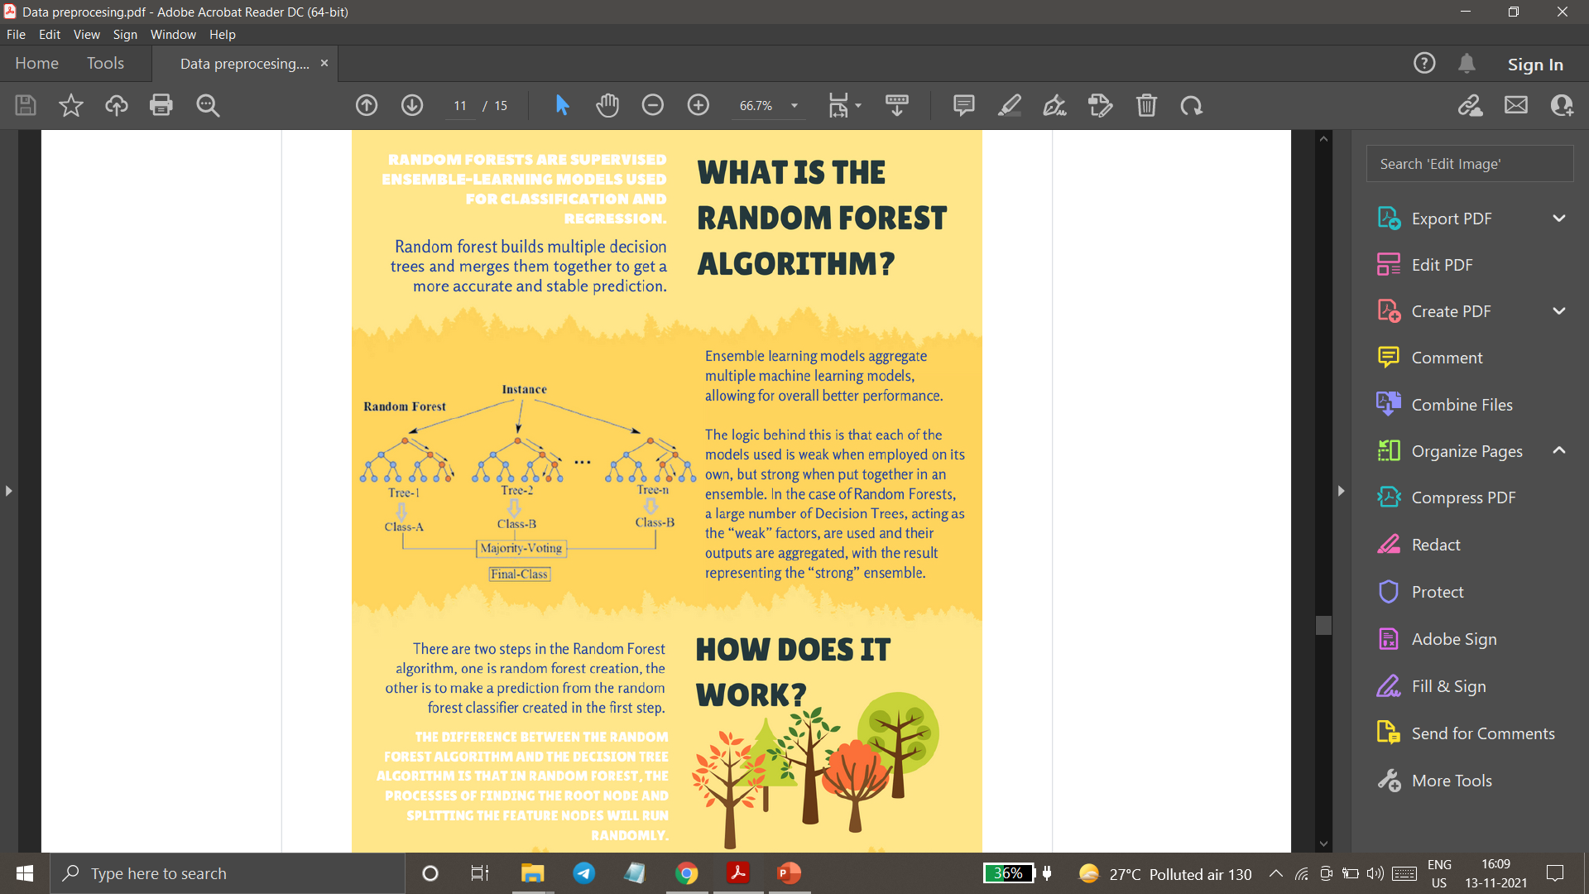
Random Forest:
Random forest are Supervised Ensemble-Learning Models used for Classification and Regression.
Random forest builds multiple decision trees and merges them together to get a more accurate and stable prediction
What is the Random Forest Algorithm ?
Ensemble learning models aggregate multiple machine algorithm models,allowing for overall better performance.
The logic behind this is that each of the models used is weak employed on its won, but strong when put together in an ensemble. In the case of Random Forests, a large number of Decision Tree, acting as the “weak” factors, are used and heir outputs are aggregated, with the result representing the “strong” ensemble.

Slide 16
How does it work ?
There are two seps in the Random Forest algorithm, one is random forest creation, the other is making prediction from the random forest classifier created in the first step.
The difference between random forest & decision tree algorithm is that in the random forest , the processes of finding the root node and splitting the feature node will run randomly.
Creation:
If the number of cases in the training set is N, sample N cases at the random-but with replacement, from the original data . This sample will be the training safe for growing the tree.
If there are M input variables, a number is specified such that at each node, m variables are selected at random out of M and the best split on this m used to split the node.
Prediction :
The random forest prediction is broken down into steps :
Take the test feature and use the rules of each randomly created decision tree to predict the outcomes and stored the predicted outcomes(target)
Calculate the oats for each predicted target
Consider the high voted predicted target as the final prediction from the random forest algorithm.

Slide 17
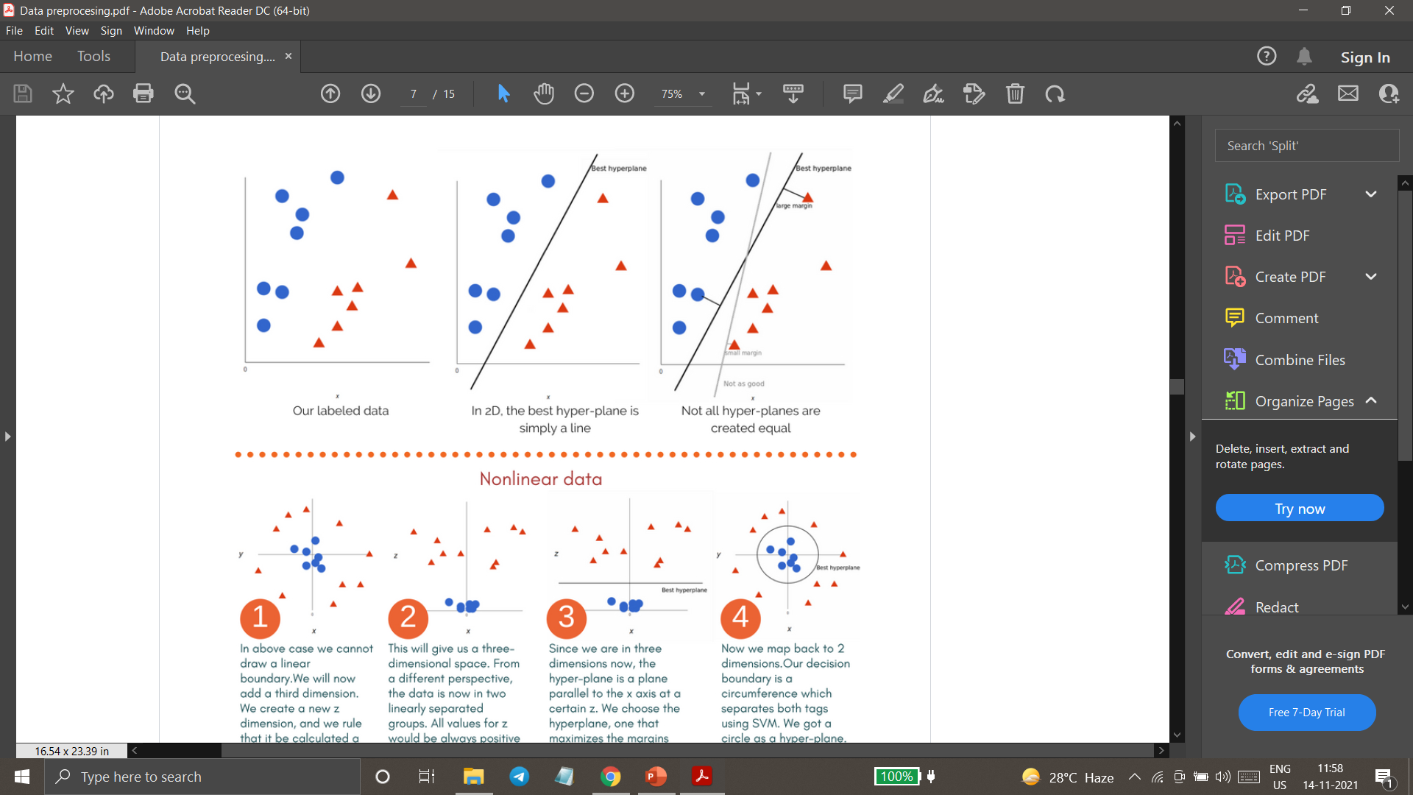
Support Vector Machines:
“ Support Vector Machine “ (SVM) is a Supervised machine Learning algorithm which can be used for both classification or regression.However , it is mostly used in classification problems.
In this algorithm, we plot each data item as a point in n-dimensional space(where n is the number of features) with the value of each feature being the value of a particular coordinate.
HOW IS THE DATA CLASSIFIED ?
We perform classification by finding the hyperplane that differentiates the two classes very well. In other words the algorithm output an optimal hyperplane which categorizes new examples.
What is a optimal Hyper-Plane?
For SVM’s , It’s the one that maximizes the margins from both tags. In other words the hyperplane whose distance to the nearest element of each tag is the largest.

Slide 18
Tuning Parameters:
KERNEL
The Learning of the hyperplane in linear SVM is done by transforming the problem using some linear algebra. This is where the kernel plays role. Polynomial and exponential kernels calculates separation line in higher dimension. This is called kernel trick
GAMMA
The Gamma parameter defines how far the influence of a single training set reaches. With low gamma, points far away from the possible separation line are considered in calculation for the separation line. Where as high gamma means the points close to possible line are considered in calculation.
REGULARIZATIO
For large values of this parameter, the optimization will choose a small- margin hyperplane if that hyperplane does a better job of getting all the training points classify correctly .
Conversely , a very small value of it will cause the optimizer to look for a large-margin separating hyperplane, even if that hyperplane misclassifies more points.
Margin
A margin is a separation of line to the closest class points.
A good margin is one where this separation is larger for both classes. A good margin allows that points to be in their respective classes without crossing to other class.

Slide 19
Support Vector Machines:
Applications of SVM :
Face Detection
Text and hypertext categorization
Classification of images
Bioinformatics
Why Support Vector Machine :
Support vector machine are the sets of supervised machine learning used for classification, regression and outlier detection.
The advantages of SVM are effective in high dimensional spaces. Still effective in cases where number of dimensions is greater than the number of samples.

Slide 20
Naïve Bayes Classifier :
Naïve bayes classifiers are belonging from simple “Probabilistic classifiers” based on Bayes theorem
P(A|B) = P(B|A).P(A) /P(B)
Naïve Bayes classifier assumes that the presence of particular feature in a class is unrelated or independent to the presence of any other feature.
Why Naive Bayes is called Naive?
We call it naive because its assumptions (it assumes that all of the features in the dataset are equally important and independent) are really optimistic and rarely true in most real-world applications:
we consider that these predictors are independent
we consider that all the predictors have an equal effect on the outcome (like the day being windy does not have more importance in deciding to play golf or not)

Slide 21
Where is Naïve Bayes Used ?
Face Recognition→ Nose, Eyes etc.
Text Classification
Weather Prediction → Rainy or sunny.
Medical Diagnosis → High Risk or Low risk for cancer disease.
News Classification → world news.
Advantages of naïve Bayes classifier:
Very Simple and easy to implement.
Needs less training data.
Handles both continuous and discrete data.
Highly scalable with number of predictors and data points.
As it is fast, it can be used in real time predictions.
Not sensitive to irrelevant features.

Slide 22
Time Series
What is a Time Series?
Time series is a sequence of observations recorded at regular time intervals.
Depending on the frequency of observations, a time series may typically be hourly, daily, weekly, monthly, quarterly and annual. Sometimes, you might have seconds and minute-wise time series as well, like, number of clicks and user visits every minute etc.
Why even analyze a time series?
Because it is the preparatory step before you develop a forecast of the series.
Besides, time series forecasting has enormous commercial significance because stuff that is important to a business like demand and sales, number of visitors to a website, stock price etc are essentially time series data.
Time series analysis involves understanding various aspects about the inherent nature of the series so that you are better informed to create meaningful and accurate forecasts.

Slide 23
PCA (Principle Component Analysis):
It is not a machine learning algorithm but it is used for reducing the dimensionality.
PCA is unsupervised machine learning technique.
PCA is used to understand data in depth.
PCA would be used in every data science project.
A BACKBONE of modern data analysis.
A black box that is widely used but poorly understood.
Application Of PCA :
To identify relation between columns.
Reduce number of columns i.e. reduce number of dimension without loosing data.
Visualize data in 2D

Slide 24
Why Dimensionality Reduction ?
Less dimensions for a given dataset means less computation or training time.
Space required to store the data is reduced.
Redundancy is removed after removing similar entries from the dataset.
Makes the data easy plotting in 2D and 3d plots.
It helps to find out the most significant features and skip the rest.
Leads to better human interpretations.
Important Terminologies :
Views The perspectives through which datapoints are observed.
Dimension Number of columns in a dataset are called the dimensions of that dataset.
Principal Component New variables that are constructed as linear combinations or mixtures of the initial variables.
Projections The perpendicular distance between the principal component and the datapoints.

Slide 25
* How PCA Works ?
PCA performs the following operation in order to evaluate the principal components for a given dataset:
Standardization → Covariance Matrix Computation → Eigen Vectors & Eigen Values → Feature Vector
Standardization:
The main aim of this step to standardize the range of the attributes so that each one of them lie within similar boundaries
The process involves the removal of mean from the variable values and scaling the data with respect to the standard deviation.
variable values – mean
Z=
Standard Deviation
Covariance Matrix Computation:
Covariance matrix is used to express the correlation between any two or more attributes in a multidimensional dataset.
Positive covariance indicate that the value of one variable is directly proportional to other variance.
Negative covariance indicate that the value of one variable is inversely proportional to other variable.
Zero covariance means two variables are independent of each other.

Slide 26
Eigen Values and Eigen Vectors:
Eigen Values and Eigen vectors are the mathematical values that are extracted from the covariance table.
They are responsible for the generation of new set of variables from old set of variable which further lead to the construction of Principal components.
* Eigen vectors do not change directions after linear transformation
* Eigen Values are the scalars or the magnitude of the Eigen vectors.
Feature Vectors:
Feature vector is simply a matrix that has eigenvector of the components that we decide to keep as the columns.
Here, we decide whether we must keep or disregard the less significant principal components that we have generated in the above steps.
Important Properties:
Numbers of principal components is always less than or equal to the number of attributes.
Principal components are orthogonal.
The priority of principal components decreases as their numbers increase.

Slide 27
Association Rule:
Study of “What goes with what” .
Association Rule is also called as a market basket analysis or affinity analysis.
How can Association Rules be used ?
Promotion on one item, raise price of related item.
Placement in store
Stocking
Product Building
What is Association Rule Mining ?
If people purchase Antecedent then there is likelihood chance to people purchase consequent
Association Rule Type :
Actional Rules (contain high-quality , actionable information )
Trivial Rules (Already well-know information by those familiar with the business)
Inexplicable Rules ( No explanation & do not suggest action)

Slide 28
Important Terminologies :
Support :
#Transaction with both antecedent & consequent item sets
#Total Transactions
Confidence :
#Transaction with both antecedent & consequent item sets
#Transaction with antecedent item sets
The Apriori Algorithm:
For K-Products
1.Set minimum support criterion
2.Generate one-item sets that meet the support criteria
3.Use list of one-item to generate two-item sets that meet support criteria…………k-item sets
Performance Measure : Lift Ratio = Confidence / benchmark Confidence
If lift ratio more than one then its good .
If lift ratio is not more than one then its not good .
Benchmark Confidence:
#Transaction with consequent item sets
#Transactions in datasets

Slide 29
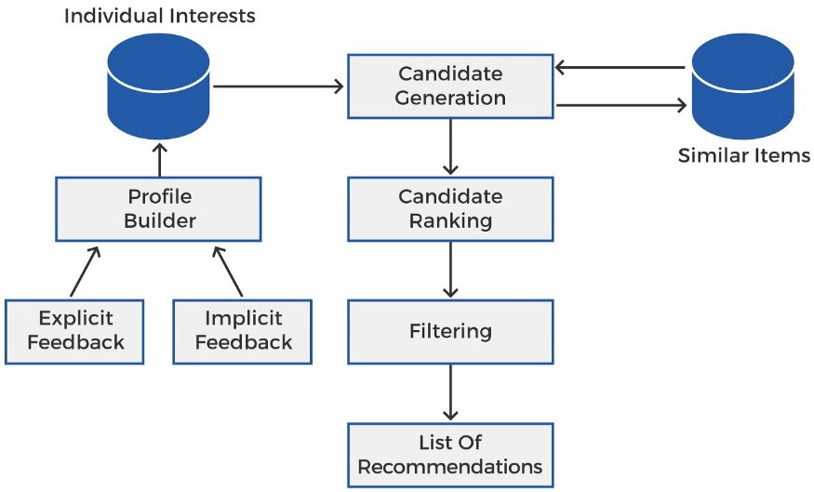
Recommender System :
Recommender systems are the systems that are designed to recommend things to the user based on many different factors.
These systems predict the most likely product that the users are most likely to purchase and are of interest to.
Companies like Netflix, Amazon, etc.
the complete recommendation system architecture and see how it works.

Slide 30
Advantages of Recommendation System :
Drive Traffic A recommendation engine can bring traffic to your site. It accomplishes this with customized e-mail messages and targeted blasts.
Engage Customers Consumers end up being more engaged in the website when individualized item recommendations are made. They are able to dive even more deeply into the product line without needing to carry out search after search.
Provide Relevant Material By analyzing the customer’s present site use and his previous browsing history, a recommendation engine can deliver appropriate product suggestions as he stores. The data is gathered in real-time so the software can respond as his shopping habits change.
Increase Average Order Value Average order values generally go up when a recommendation engine in uses to show tailored alternatives. Advanced metrics and reporting can definitively reveal the efficiency of a project.
Boost Number of Items per Order In addition to the average order value rising, the number of products per order likewise typically increases when a recommendation engine is used. When the customer is revealed options that fulfill his interest, he is most likely to add choices to his purchase.

Slide 31
DEEP LEARNING:
Deep Learning is a Machine Learning Technique that teaches computer to do what comes naturally to humans learn by example
Neural Network :
A neural network is a system of hardware and/ or software patterned after the operation of neurons in the human brain. Neural network also called artificial neural network is a way to achieving deep learning.
ANN models the relationship between a set of input signals and output signals.
Advantages of Artificial Neural Network :
An artificial neural networks outputs aren’t limited entirely but inputs and results given to them initially by an expert system. This ability comes in handy for robotics and pattern recognition systems
ANN have the potential for high fault tolerance
ANN are capable of debugging or diagnosing a network on their own.
Non-linear systems have the capability of finding shortcuts to reach computationally expensive solutions.

Slide 32
Application of ANN:
Stock exchange prediction There are many factors that effect the stock market, Neural Network can examine a lot of factors and predict the price on a daily basis helping the stock brokers.
Handwriting Recognition Neural Network is used to convert handwriting characters into digital characters that the system can recognize.
Travelling salesman problem It refers to finding the optimal path to travel between all cities in an area. Neural Network helps solve this problem providing higher revenue at a minimal cost.
Image Compression Idea behind data compression neural networks is to store, encrypt and re-create the actual image again.

Slide 33
Natural Language Processing(NLP) :
NLP is Method to analyze language in text and speech by computer.
Text Mining(TM):
The use of computational methods and techniques to extract high quality information from text.
Why TM relevant / useful ?
Because the huge amount of unstructured text is present in various form and in huge and ever increasing quantities . Books , financial and other business reports, blogs posts etc.,.
Application of NLP:
1.Use of google assessments.
2.Document classification.
3.Clustering \ organizing documents
4.Translators.
5.Document similarity system.

Slide 34
Tokenization:
Tokenization is breaks sentence into chunks (Word) called tokes. Breakdown larger pieces of text chunks into smaller meaningful ones.
Stemming :
The process of reducing Infracted words (Uncommon) from the STEM.
Why stemming is important ?
NLP is used for sentimental analysis, used cases like hotel review, the most important things that people gives comments word stem words which is preety much imp using this words, by this word it is preety much easy to understand that word is positive or negative.
Lemmatization :
Also gives same things but we get meaningful words.
For Feature Selection we used:
1.Bag of Words
2.TF-IDF
3.Word2vec technique

